Slide 1
Sect. 5.5 Applications of Trigonometry
© Copyright all rights reserved to Homework depot: www.BCMath.ca

Slide 2
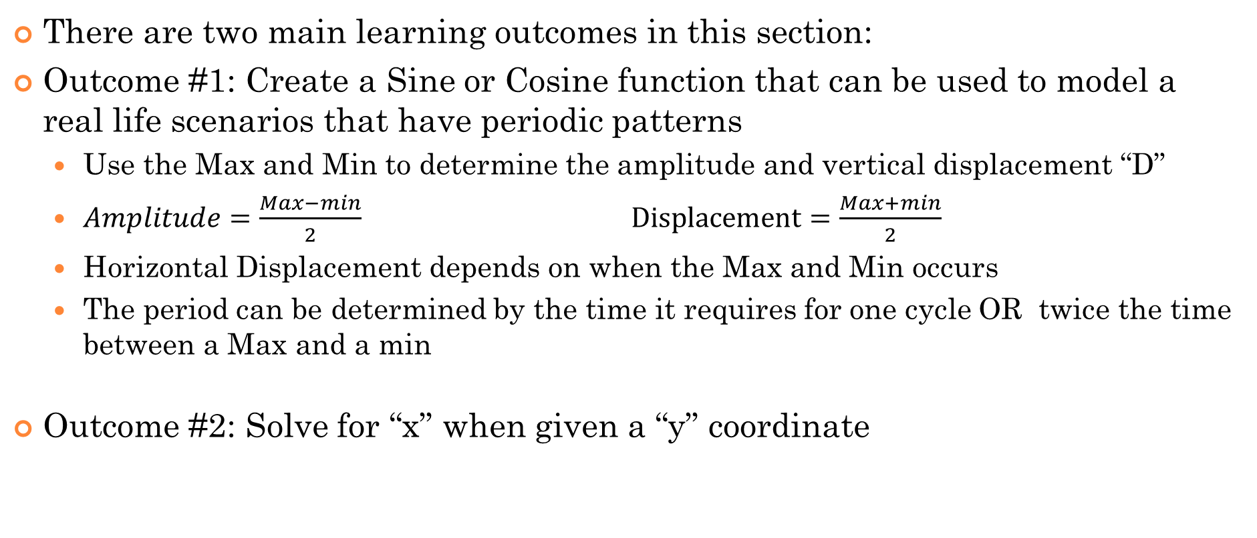
Learning Outcomes:
There are two main learning outcomes in this section:
Outcome #1: Create a Sine or Cosine function that can be used to model a real life scenarios that have periodic patterns
  Use the Max and Min to determine the amplitude and vertical displacement “D”
  $Amplitude=\frac{Max−min}{2} \text{Displacement}=\frac{Max+min}{2}$
  Horizontal Displacement depends on when the Max and Min occurs
  The period can be determined by the time it requires for one cycle OR twice the time between a Max and a min
Outcome #2: Solve for “x” when given a “y” coordinate

Slide 3
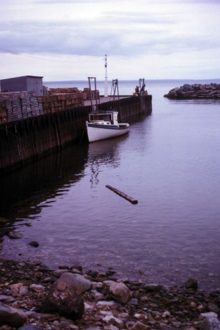
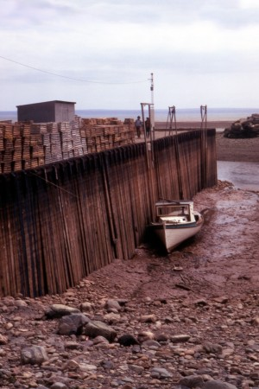
II) Ocean Tides
Earth's ocean surface will rise and fall periodically
High tide occurs when water level peaks
Low tide occurs when ocean levels is at it’s minimum
When water levels begin to change (Slack point/ Turning)
Caused by the gravitational pulls from the Moon and the Sun acting on the oceans (wikipedia)
As the moon rotates around the earth, different parts of the moon will generate different amounts of gravitatonal pull on the ocean surface
Important for coastal navigation
http://en.wikipedia.org/wiki/Tidal_force
High tide at
Bay of Fundy
Low tide at
Bay of Fundy
© Copyright all rights reserved to Homework depot: www.BCMath.ca

Slide 4
Ex: If high tide (10.6m) occur at 3:30am and low tide (3.9m) is 8.5 hours later,
a) Write a Sine Function and Cosine Function for the depth of the water at any time, t hours, within a day.
b) Graph the function
c) How high is the tide at 8am?
d) In order to set sail for a large boat, the tide must be at least 9meters high. In a 24 hour cycle, during what times can you set sail?

Slide 5

Ex: If high tide (10.6m) occur at 3:30am and low tide (3.9m) is 8.5 hours later, write an equation for the depth of the water at any time, t hours.
High tide occurs at 3:30am
with ocean depths at 10.9m
Ocean levels will fluctuate
up and down over several hours
Low tide occurs 8.5 hours later
with ocean levels at 3.9m
© Copyright all rights reserved to Homework depot: www.BCMath.ca

Slide 6
Ex: If high tide (10.6m) occur at 3:30am and low tide (3.9m) is 8.5 hours later, write an equation for the depth of the water at any time, t hours.
y
High Tide
High Tide
11
10
9
8
7
6
5
4
3
Low Tide
2
1
x
0
2
4
6
8
10
12
14
16
18
20
22
© Copyright all rights reserved to Homework depot: www.BCMath.ca

Slide 7
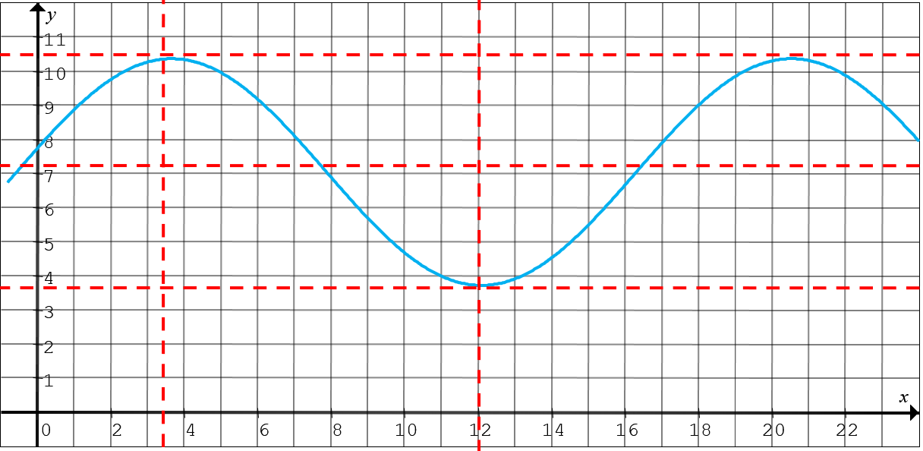
To convert this graph into a sine function, just change where the graph begins. Instead at the highest point, start ¼ of the period to the left!
Period = 17
¼ Period = 17/4 = 4.5
Between the times of 12:45am to 6:14am and 5:45pm to 11:14pm, the height of the tide is 9m or higher. These are times that you can set sail.

Slide 8
III) Ferris Wheel Problem:
A Ferris Wheel at a park has riders get on at the bottom of the wheel, which is 11m above the ground. The highest point of the ride is 55m above ground. The ride takes 120s to complete one revolution. Derive a formula in the form of :
for the height of a rider.
y
40
20
0
20
40
60
80
100
x
120
© Copyright all rights reserved to Homework depot: www.BCMath.ca

Slide 9
A Ferris Wheel at a park has riders get on at the bottom of the wheel, which is 11m
above the ground. The highest point of the ride is 55m above ground. The ride takes
120s to complete one revolution.
a) Derive a Cosine Function that determines the height of the passenger as a function of time (t) from when they get on
b) Derive a Sine Function for the height of the passengers as a function of time
c) Graph the height of the passenger on the ferris wheel as a function of time
d)What is the height of the passenger after 30s on the ferris wheel?
e) After how many seconds from getting on will the passenger be at the maximum height?
f) Suppose the ride makes two full revolutions, for how many seconds will passengers be above 40meters tall when they are on the Ferris wheel?

Slide 10
The height of the rider v.s. time creates a sinusoidal wave
To find the formula for the equation, use the graph to obtain the amplitude, period, vertical & horizontal shifts
y
40
20
0
20
40
60
80
100
x
120
No horizontal shift, the graph begins at t = 0.
However, there’s a vertical reflection. (Upside Down Cosine Function) Graph begins at the bottom
If you want to write it as a sine function, start
the graph ¼ period to the right (30s)
© Copyright all rights reserved to Homework depot: www.BCMath.ca

Slide 11
Q1: Find the height of the rider 30seconds after the ride begins:
The height of the rider after 30s will be 33meters above the ground
Q2: Within 1 complete revolution, what is the total amount of time a rider on the ferris wheel will spend above 40m?
y
Find the intersection points
between the two functions
The time above 40m will be
the horizontal difference between the two points
40
20
Multiply this by 2 for 2 cycles:
0
20
40
60
80
100
x
120
© Copyright all rights reserved to Homework depot: www.BCMath.ca

Slide 12
IV) Earth and Sun in the Solar System
The earth circulates in an elliptical orbit around the sun
Perogee (Perihelion) point in orbit where the earth-sun distance is at its minimum (early January - Winter)
  Distance = 147.5 million km (2008)
Apogee (Aphelion) point in orbit where the earth-sun distance is at its maximum (early July - Summer)
  Distance = 152.6 million km (2008)
Earth’s orbit is stabilizing, but changes slightly every year
http://en.wikipedia.org/wiki/Apsis
Note: Seasons depend on earth’s axis of orbit, not on earth-sun distance
© Copyright all rights reserved to Homework depot: www.BCMath.ca

Slide 13


Aphelion: Distance between
the earth and sun is longest
at this point.
D=152.6 million km
Perihelion: distance
between the earth and
sun is shortest at this point
D = 147.5million km
http://www.spaceweather.com/glossary/aphelion.html
© Copyright all rights reserved to Homework depot: www.BCMath.ca

Slide 14
Ex: In 2020, perihelion is on January 5 and aphelion is on July 4 (180 days in between).
Perihelion (147,000,000km) Aphelion (149,600,000km)
a) Express the distance, d million km, from Earth to sun as a sinusoidal function of the number of days of the year.
b) Express the distance, “d” million km, from Earth to sun as a “Cosine Function”
c) Graph the distance of the earth from the sun as a function of the time (days) in the year
d) Use the function to find the earth/sun distance on Dec 13, 2020

Slide 15
Ex: In 2020, perihelion is on January 5 and aphelion is on July 4. Express the distance, d million km, from Earth to sun as a sinusoidal function of the number of days of the year.
b) Use the function to find the earth/sun distance on Dec 13, 2020
y
154
153
Aphelion
152
151
150
149
148
147
Perihelion
146
0
30
60
90
120
150
180
210
240
270
300
330
360
© Copyright all rights reserved to Homework depot: www.BCMath.ca

Slide 16
Distance between Earth and mars:
The distance btween Earth and Mars are measured in “Astronomical Units” (AU), where 1AU is approx. 150million km, the distance between Earth and Sun
Minimum Distance is approx. 0.4AU and Max Distance is approx. 2.66AU
The minimum distances appear approximately every 2.1 years
The graph below shows the distance between earth and Mars:

Slide 17
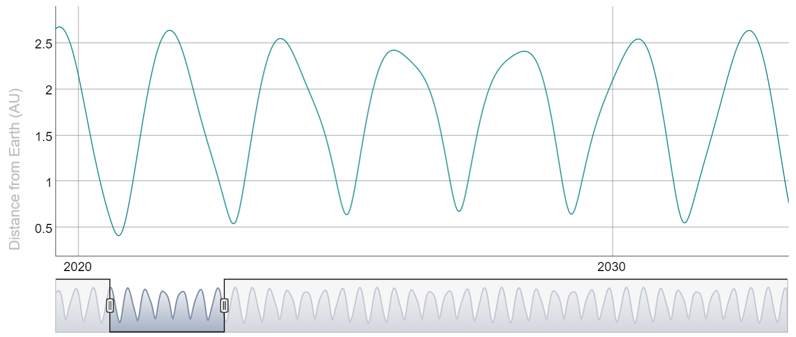
Distance Between Earth and mars (10years)

Slide 18
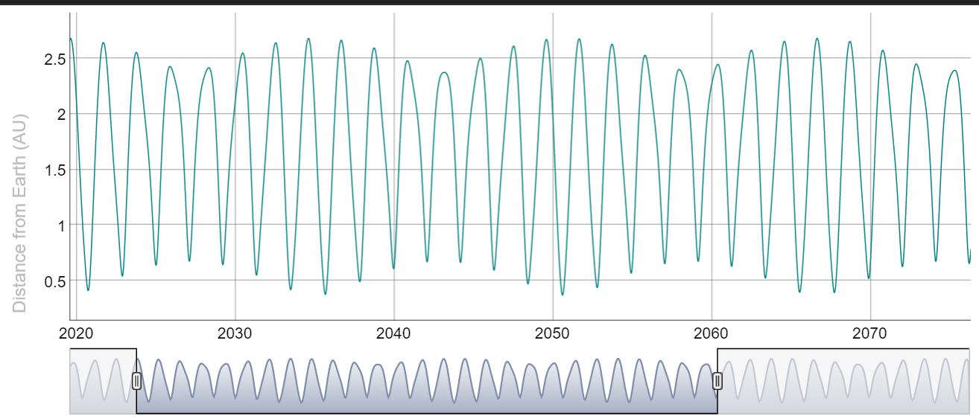
Distance Between Earth and mars (50years)

Slide 19
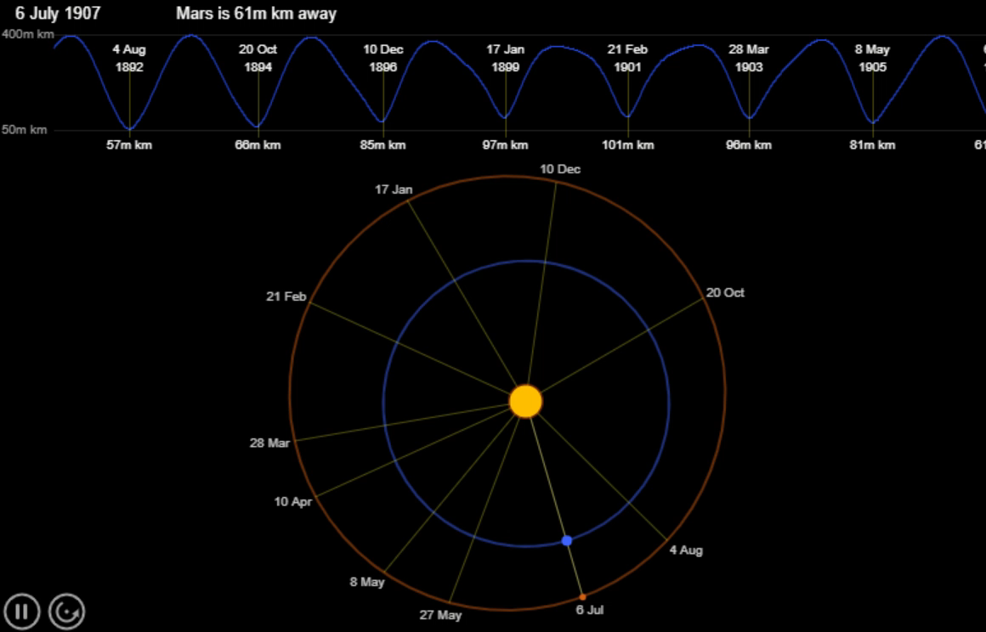
Earth to mars:
https://www.khanacademy.org/nasa/distance-between-earth-and-mars/5145009707810816

Slide 20
On Dec 1, 2022 the distance between Earth and Mars was at a minimum of 81.51million km (0.544AU). The next time earth and mars will reach a minimum is on January 11, 2025 with a distance of 96.12million km (0.64AU). On average the farthest distance is approx. 2.5AU.
a) Write a Cosine function for the earth mars distance on the number of days after December 1, 2022. Use “AU” to represent the distance.
b) How far is the earth/mars today?
https://theskylive.com/how-far-is-mars

Slide 21
Deriving an Trig. Function:
When trying to derive a trig function, the difference between the location of two maximum points OR two minimum points is equal to the period
The horizontal difference between a Max and Min is half the period
The horizonal difference between two maximum points or two minimum points is the period
The vertical difference between a maximum point and a minimum point is twice the amplitude
The average of the vertical distance between a maximum point and a minimum point is the vertical displacement/shift

